Slide 1
Week 5
SQL – implementing our case study in mysql

Slide 2
Student Objectives
Upon completion of this video, you should be able to:
Create tables
Insert data into tables
Query the tables by joining them together
Using SQL, implement a projection, selection, join, Cartesian product, union, intersection and difference.
Alter and drop tables
Create indices on tables

Slide 3
Example – Step 1→ CREATE your Database and TABLEs
Connect to your virtual machine and let’s set up the employee, department, project, workson database:
http://www.csd.uwo.ca/~lreid/cs3319/sqlscripts/

Slide 4
CREATE database mycompany;
USE mycompany;
CREATE TABLE department (deptno CHAR(3), deptname VARCHAR(20), deptlocation VARCHAR(20));
CREATE TABLE project (projectid VARCHAR(3), projectname VARCHAR(20), projectloation VARCHAR(20), deptno CHAR(3), PRIMARY KEY (projectid) FOREIGN KEY (deptno) REFERENCES department(deptno));
CREATE TABLE employee (SSN VARCHAR(9) not null, lastname VARCHAR(20), firstname VARCHAR(20), sex CHAR(1), deptno char (3), PRIMARY KEY (SSN) FOREIGN KEY (deptno) REFERENCES department(deptno));
CREATE TABLE workson (SSN VARCHAR(9), projectid VARCHAR(3), hours int, PRIMARY KEY (SSN, projectid) FOREIGN KEY(SSN) REFERENCES department(SSN), FOREIGN KEY(projectid) REFERENCES project(projectid));

Slide 5
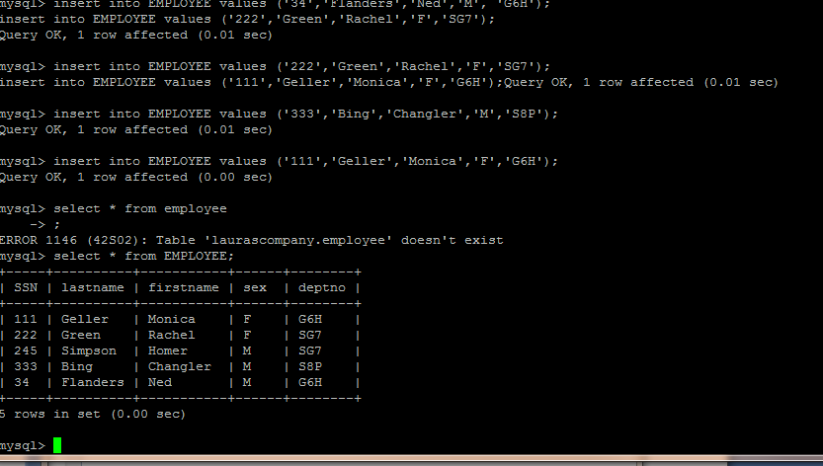
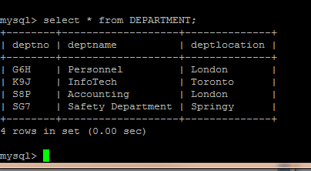
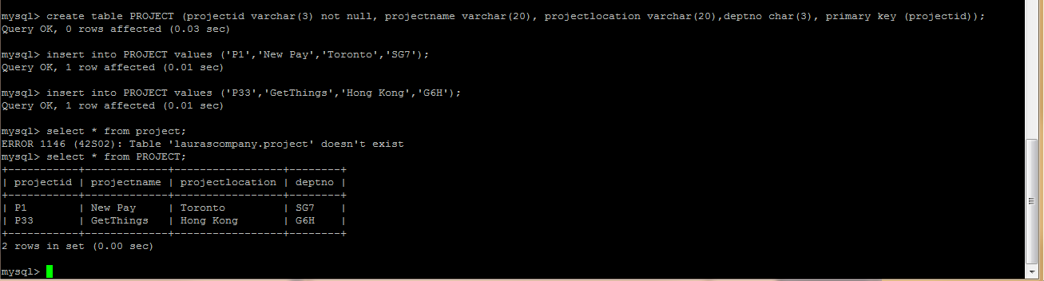
Step 2: Put some data into your TABLEs

Slide 6
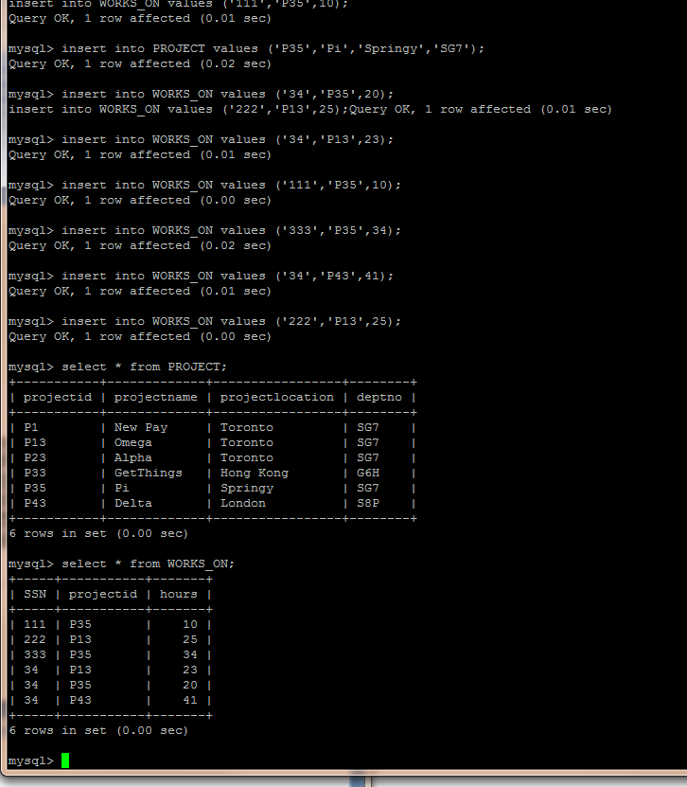

Slide 7
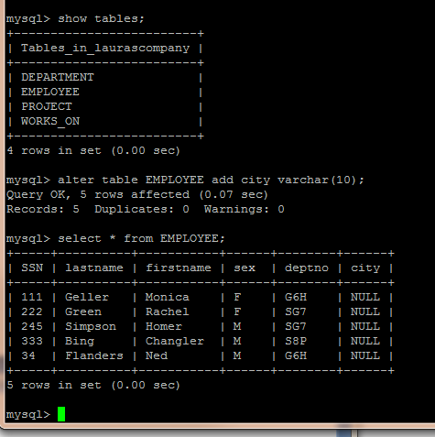

Slide 8
http://www.csd.uwo.ca/~lreid/cs3319/sqlscripts/insertingexample.txt
USE mycompany;
INSERT INTO department values("G8H","Personnel","London");
INSERT INTO department values("K9J","InfoTech","Toronto");
INSERT INTO department values("S8P","Accounting","London");
INSERT INTO department values("SG7","Safety Department","Springy");
INSERT INTO employee values("111","Geller","Monica","F","G8H");
INSERT INTO employee values("222","Green","Rachel","F","SG7");
INSERT INTO employee values("245","Simpson","Homer","M","SG7");
INSERT INTO employee values("333","Bing","Changler","M","S8P");
INSERT INTO employee values("34","Flanders","Ned","M","G8H");
INSERT INTO project VALUES ("P1", "New Pay", "Toronto", "SG7");
INSERT INTO project VALUES ("P13", "Omega", "Toronto", "SG7");
INSERT INTO project VALUES ("P23", "Alpha", "Toronto", "SG7");
INSERT INTO project VALUES ("P33", "GetThings", "Hong Kong", "G8H");
INSERT INTO project VALUES ("P35", "Pi", "Springy", "SG7");
INSERT INTO project VALUES ("P43", "Delta", "London", "S8P");
INSERT INTO workson VALUES ("111","P35",10);
INSERT INTO workson VALUES ("222","P13",25);
INSERT INTO workson VALUES ("333","P35",34);
INSERT INTO workson VALUES ("34","P13",23);
INSERT INTO workson VALUES ("34","P35",20);
INSERT INTO workson VALUES ("34","P43",41);

Slide 9
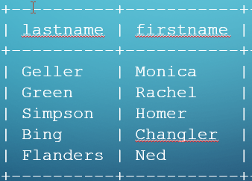
Step 3: Do Some Queries using SQL
Projection:
SELECT attribute1, attribute2 FROM TABLEname;
e.g. SELECT firstname, lastname FROM employee;
5 rows in set (0.00 sec)

Slide 10
Question: What do you think: SELECT DISTINCT lastname FROM employee;
does?
mysql> SELECT sex FROM employee;
+------+
| sex |
+------+
| F |
| F |
| M |
| M |
| M |
+------+
5 rows in set (0.00 sec)
mysql> SELECT DISTINCT sex FROM employee;
+------+
| sex |
+------+
| F |
| M |
+------+
2 rows in set (0.00 sec)

Slide 11
Selection:
SELECT * FROM TABLEname WHERE condition; (* gives all fields)
e.g.
SELECT * FROM employee WHERE sex=“F”;
SELECT firstname, lastname FROM employee WHERE sex=‘F’;
mysql> SELECT * FROM employee WHERE sex="F";
+-----+----------+-----------+------+--------+
| SSN | lastname | firstname | sex | deptno |
+-----+----------+-----------+------+--------+
| 111 | Geller | Monica | F | G8H |
| 222 | Green | Rachel | F | SG7 |
+-----+----------+-----------+------+--------+
2 rows in set (0.00 sec)
mysql> SELECT firstname,lastname FROM employee WHERE sex="F";
+-----------+----------+
| firstname | lastname |
+-----------+----------+
| Monica | Geller |
| Rachel | Green |
+-----------+----------+
2 rows in set (0.00 sec)

Slide 12
SELECT * FROM employee WHERE city IS NULL AND sex=“F”;
+-----+----------+-----------+------+--------+------+
| SSN | lastname | firstname | sex | deptno | city |
+-----+----------+-----------+------+--------+------+
| 111 | Geller | Monica | F | G6H | NULL |
| 222 | Green | Rachel | F | SG7 | NULL |
+-----+----------+-----------+------+--------+------+
2 rows in set (0.00 sec) 5 record(s) selected.
SELECT * FROM employee ORDER BY firstname;
+-----+----------+-----------+------+--------+------+
| SSN | lastname | firstname | sex | deptno | city |
+-----+----------+-----------+------+--------+------+
| 333 | Bing | Changler | M | S8P | NULL |
| 245 | Simpson | Homer | M | SG7 | NULL |
| 111 | Geller | Monica | F | G6H | NULL |
| 34 | Flanders | Ned | M | G6H | NULL |
| 222 | Green | Rachel | F | SG7 | NULL |
+-----+----------+-----------+------+--------+------+
5 rows in set (0.00 sec)

Slide 13
SELECT COUNT(*) FROM employee; +----------+
| COUNT(*) |
+----------+
| 5 |
+----------+ SELECT COUNT(sex) FROM employee; +------------+
| COUNT(sex) |
+------------+
| 5 |
+------------+ SELECT COUNT(DISTINCT sex) FROM employee; +---------------------+
| COUNT(DISTINCT sex) |
+---------------------+
| 2 |
+---------------------+
1 row in set (0.00 sec)

Slide 14
SELECT * FROM workson; +-----+-----------+-------+
| SSN | projectid | hours |
+-----+-----------+-------+
| 111 | P35 | 10 |
| 222 | P13 | 25 |
| 333 | P35 | 34 |
| 34 | P13 | 23 |
| 34 | P35 | 20 |
| 34 | P43 | 41 |
+-----+-----------+-------+
6 rows in set (0.00 sec) SELECT ssn FROM workson WHERE hours > 25; +-----+
| ssn |
+-----+
| 333 |
| 34 |
+-----+
2 rows in set (0.00 sec) SELECT * FROM workson WHERE projectid = 'P35' AND hours > 20; +-----+-----------+-------+
| SSN | projectid | hours |
+-----+-----------+-------+
| 333 | P35 | 34 |
+-----+-----------+-------+
1 row in set (0.00 sec)

Slide 15
mysql>SELECT * FROM employee;
+-----+----------+-----------+------+--------+------+
| SSN | lastname | firstname | sex | deptno | city |
+-----+----------+-----------+------+--------+------+
| 111 | Geller | Monica | F | G6H | NULL |
| 222 | Green | Rachel | F | SG7 | NULL |
| 245 | Simpson | Homer | M | SG7 | NULL |
| 333 | Bing | Changler | M | S8P | NULL |
| 34 | Flanders | Ned | M | G6H | NULL |
+-----+----------+-----------+------+--------+------+
5 rows in set (0.00 sec)
mysql> SELECT COUNT(*) FROM employee;
+----------+
| COUNT(*) |
+----------+
| 5 |
+----------+
1 row in set (0.00 sec)
mysql> SELECT deptno, COUNT(*) FROM employee GROUP BY deptno;
+--------+----------+
| deptno | COUNT(*) |
+--------+----------+
| G6H | 2 |
| S8P | 1 |
| SG7 | 2 |
+--------+----------+
3 rows in set (0.00 sec)

Slide 16
Cartesian Product:
mysql> SELECT * FROM employee, department;
+-----+----------+-----------+------+--------+--------+-------------------+--------------+
| SSN | lastname | firstname | sex | deptno | deptno | deptname | deptlocation |
+-----+----------+-----------+------+--------+--------+-------------------+--------------+
| 111 | Geller | Monica | F | G8H | G8H | Personnel | London |
| 111 | Geller | Monica | F | G8H | K9J | InfoTech | Toronto |
| 111 | Geller | Monica | F | G8H | S8P | Accounting | London |
| 111 | Geller | Monica | F | G8H | SG7 | Safety Department | Springy |
| 222 | Green | Rachel | F | SG7 | G8H | Personnel | London |
| 222 | Green | Rachel | F | SG7 | K9J | InfoTech | Toronto |
| 222 | Green | Rachel | F | SG7 | S8P | Accounting | London |
| 222 | Green | Rachel | F | SG7 | SG7 | Safety Department | Springy |
| 245 | Simpson | Homer | M | SG7 | G8H | Personnel | London |
| 245 | Simpson | Homer | M | SG7 | K9J | InfoTech | Toronto |
| 245 | Simpson | Homer | M | SG7 | S8P | Accounting | London |
| 245 | Simpson | Homer | M | SG7 | SG7 | Safety Department | Springy |
| 333 | Bing | Changler | M | S8P | G8H | Personnel | London |
| 333 | Bing | Changler | M | S8P | K9J | InfoTech | Toronto |
| 333 | Bing | Changler | M | S8P | S8P | Accounting | London |
| 333 | Bing | Changler | M | S8P | SG7 | Safety Department | Springy |
| 34 | Flanders | Ned | M | G8H | G8H | Personnel | London |
| 34 | Flanders | Ned | M | G8H | K9J | InfoTech | Toronto |
| 34 | Flanders | Ned | M | G8H | S8P | Accounting | London |
| 34 | Flanders | Ned | M | G8H | SG7 | Safety Department | Springy |
+-----+----------+-----------+------+--------+--------+-------------------+--------------+
20 rows in set (0.00 sec)

Slide 17
Joins:
mysql> SHOW TABLES;
+---------------------+
| TABLES_in_mycompany |
+---------------------+
| department |
| employee |
| project |
| workson |
+---------------------+
4 rows in set (0.00 sec)
mysql> SELECT * FROM employee;
+-----+----------+-----------+------+--------+
| SSN | lastname | firstname | sex | deptno |
+-----+----------+-----------+------+--------+
| 111 | Geller | Monica | F | G8H |
| 222 | Green | Rachel | F | SG7 |
| 245 | Simpson | Homer | M | SG7 |
| 333 | Bing | Changler | M | S8P |
| 34 | Flanders | Ned | M | G8H |
+-----+----------+-----------+------+--------+
5 rows in set (0.00 sec)

Slide 18
mysql> SELECT * FROM department;
+--------+-------------------+--------------+
| deptno | deptname | deptlocation |
+--------+-------------------+--------------+
| G8H | Personnel | London |
| K9J | InfoTech | Toronto |
| S8P | Accounting | London |
| SG7 | Safety Department | Springy |
+--------+-------------------+--------------+
4 rows in set (0.00 sec)
mysql> SELECT lastname FROM employee WHERE deptno = "SG7";
+----------+
| lastname |
+----------+
| Green |
| Simpson |
+----------+
2 rows in set (0.00 sec)
mysql> SELECT deptname FROM department;
+-------------------+
| deptname |
+-------------------+
| Personnel |
| InfoTech |
| Accounting |
| Safety Department |
+-------------------+
4 rows in set (0.00 sec)

Slide 19
mysql> SELECT deptname FROM department WHERE deptno="SG7";
+-------------------+
| deptname |
+-------------------+
| Safety Department |
+-------------------+
1 row in set (0.00 sec)
mysql> SELECT lastname FROM employee WHERE deptno IN (SELECT deptno FROM department WHERE deptname="Safety Department");
+----------+
| lastname |
+----------+
| Green |
| Simpson |
+----------+
2 rows in set (0.00 sec)
mysql> SELECT lastname FROM employee, department WHERE employee.deptno=department.deptno and department.deptname="Safety Department";
+----------+
| lastname |
+----------+
| Green |
| Simpson |
+----------+
2 rows in set (0.00 sec)

Slide 20
mysql> SELECT * FROM employee RIGHT OUTER JOIN department ON employee.deptno=department.deptno;
+------+----------+-----------+------+--------+--------+-------------------+--------------+
| SSN | lastname | firstname | sex | deptno | deptno | deptname | deptlocation |
+------+----------+-----------+------+--------+--------+-------------------+--------------+
| 111 | Geller | Monica | F | G8H | G8H | Personnel | London |
| 34 | Flanders | Ned | M | G8H | G8H | Personnel | London |
| NULL | NULL | NULL | NULL | NULL | K9J | InfoTech | Toronto |
| 333 | Bing | Changler | M | S8P | S8P | Accounting | London |
| 222 | Green | Rachel | F | SG7 | SG7 | Safety Department | Springy |
| 245 | Simpson | Homer | M | SG7 | SG7 | Safety Department | Springy |
+------+----------+-----------+------+--------+--------+-------------------+--------------+
6 rows in set (0.00 sec)
NOTE: Full outer join would be: SELECT * FROM EMPLOYEE FULL JOIN DEPARTMENT ON DEPARTMENT.DEPTNO = EMPLOYEE.DEPTNO

Slide 21
Union:
First, let’s add a city column to the employee TABLE:
mysql> ALTER TABLE employee ADD city VARCHAR(20);
Query OK, 5 rows affected (0.18 sec)
Records: 5 Duplicates: 0 Warnings: 0mysql> SELECT * FROM employee;
+-----+----------+-----------+------+--------+------+
| SSN | lastname | firstname | sex | deptno | city |
+-----+----------+-----------+------+--------+------+
| 111 | Geller | Monica | F | G8H | NULL |
| 222 | Green | Rachel | F | SG7 | NULL |
| 245 | Simpson | Homer | M | SG7 | NULL |
| 333 | Bing | Changler | M | S8P | NULL |
| 34 | Flanders | Ned | M | G8H | NULL |
+-----+----------+-----------+------+--------+------+
5 rows in set (0.00 sec)
mysql> UPDATE employee SET city="Calgary" WHERE sex="F";
Query OK, 2 rows affected (0.00 sec)
Rows matched: 2 Changed: 2 Warnings: 0
mysql> UPDATE employee SET city="Halifax" WHERE sex="M";
Query OK, 3 rows affected (0.01 sec)
Rows matched: 3 Changed: 3 Warnings: 0

Slide 22
mysql> SELECT * FROM department;
+--------+-------------------+--------------+
| deptno | deptname | deptlocation |
+--------+-------------------+--------------+
| G8H | Personnel | London |
| K9J | InfoTech | Toronto |
| S8P | Accounting | London |
| SG7 | Safety Department | Springy |
+--------+-------------------+--------------+
4 rows in set (0.00 sec)
mysql> SELECT deptlocation FROM department UNION (SELECT city FROM employee);
+--------------+
| deptlocation |
+--------------+
| London |
| Toronto |
| Springy |
| Calgary |
| Halifax |
+--------------+
5 rows in set (0.00 sec)

Slide 23
Intersection:
mysql> SELECT deptlocation FROM department;
+--------------+
| deptlocation |
+--------------+
| London |
| Toronto |
| London |
| Springy |
+--------------+
4 rows in set (0.00 sec)
mysql> SELECT projectloation FROM project;
+----------------+
| projectloation |
+----------------+
| Toronto |
| Toronto |
| Toronto |
| Hong Kong |
| Springy |
| London |
+----------------+
6 rows in set (0.00 sec)
mysql> SELECT DISTINCT department.deptlocation FROM department JOIN project ON project.projectloation=department.deptlocation;
+--------------+
| deptlocation |
+--------------+
| Toronto |
| Springy |
| London |
+--------------+
3 rows in set (0.00 sec)

Slide 24
Difference:
mysql> SELECT deptlocation FROM department;
+--------------+
| deptlocation |
+--------------+
| London |
| Toronto |
| London |
| Springy |
+--------------+
4 rows in set (0.00 sec)
mysql> SELECT projectloation FROM project;
+----------------+
| projectloation |
+----------------+
| Toronto |
| Toronto |
| Toronto |
| Hong Kong |
| Springy |
| London |
+----------------+
6 rows in set (0.00 sec)
mysql> SELECT projectloation FROM project WHERE projectloation NOT IN (SELECT deptlocation FROM department);
+----------------+
| projectloation |
+----------------+
| Hong Kong |
+----------------+
1 row in set (0.00 sec)

Slide 25
Wildcards/Pattern Matching:
mysql> SELECT * FROM project WHERE projectloation LIKE '%on%';
+-----------+-------------+----------------+--------+
| projectid | projectname | projectloation | deptno |
+-----------+-------------+----------------+--------+
| P1 | New Pay | Toronto | SG7 |
| P13 | Omega | Toronto | SG7 |
| P23 | Alpha | Toronto | SG7 |
| P33 | GetThings | Hong Kong | G8H |
| P43 | Delta | London | S8P |
+-----------+-------------+----------------+--------+
5 rows in set (0.00 sec)
mysql> SELECT * FROM project WHERE projectid LIKE 'P_3';
+-----------+-------------+----------------+--------+
| projectid | projectname | projectloation | deptno |
+-----------+-------------+----------------+--------+
| P13 | Omega | Toronto | SG7 |
| P23 | Alpha | Toronto | SG7 |
| P33 | GetThings | Hong Kong | G8H |
| P43 | Delta | London | S8P |
+-----------+-------------+----------------+--------+
4 rows in set (0.00 sec)

Slide 26
Updating Records
mysql> UPDATE employee SET city ="Montreal";
Query OK, 5 rows affected (0.01 sec)
Rows matched: 5 Changed: 5 Warnings: 0
mysql> SELECT * FROM employee;
+-----+----------+-----------+------+--------+----------+
| SSN | lastname | firstname | sex | deptno | city |
+-----+----------+-----------+------+--------+----------+
| 111 | Geller | Monica | F | G8H | Montreal |
| 222 | Green | Rachel | F | SG7 | Montreal |
| 245 | Simpson | Homer | M | SG7 | Montreal |
| 333 | Bing | Changler | M | S8P | Montreal |
| 34 | Flanders | Ned | M | G8H | Montreal |
+-----+----------+-----------+------+--------+----------+
5 rows in set (0.00 sec)
mysql> UPDATE employee SET city="Abu Dhabi" WHERE sex="F";
Query OK, 2 rows affected (0.00 sec)
Rows matched: 2 Changed: 2 Warnings: 0
mysql> SELECT * FROM employee;
+-----+----------+-----------+------+--------+-----------+
| SSN | lastname | firstname | sex | deptno | city |
+-----+----------+-----------+------+--------+-----------+
| 111 | Geller | Monica | F | G8H | Abu Dhabi |
| 222 | Green | Rachel | F | SG7 | Abu Dhabi |
| 245 | Simpson | Homer | M | SG7 | Montreal |
| 333 | Bing | Changler | M | S8P | Montreal |
| 34 | Flanders | Ned | M | G8H | Montreal |
+-----+----------+-----------+------+--------+-----------+
5 rows in set (0.00 sec)

Slide 27
Deleting Records:
mysql> SELECT * FROM employee;
+-----+----------+-----------+------+--------+-----------+
| SSN | lastname | firstname | sex | deptno | city |
+-----+----------+-----------+------+--------+-----------+
| 111 | Geller | Monica | F | G8H | Abu Dhabi |
| 222 | Green | Rachel | F | SG7 | Abu Dhabi |
| 245 | Simpson | Homer | M | SG7 | Montreal |
| 333 | Bing | Changler | M | S8P | Montreal |
| 34 | Flanders | Ned | M | G8H | Montreal |
+-----+----------+-----------+------+--------+-----------+
5 rows in set (0.00 sec)
mysql> DELETE FROM employee WHERE firstname LIKE "N%";
ERROR 1451 (23000): Cannot delete or update a parent row: a FOREIGN KEY constraint fails (`mycompany`.`workson`, CONSTRAINT `workson_ibfk_1` FOREIGN KEY (`SSN`) REFERENCES `employee` (`SSN`))
mysql> SELECT * FROM workson;
+-----+-----------+-------+
| SSN | projectid | hours |
+-----+-----------+-------+
| 222 | P13 | 25 |
| 333 | P35 | 34 |
| 34 | P13 | 23 |
| 34 | P35 | 20 |
| 34 | P43 | 41 |
+-----+-----------+-------+
5 rows in set (0.00 sec)
mysql> DELETE FROM employee WHERE firstname LIKE "M%";
Query OK, 1 row affected (0.02 sec)

Slide 28
Step 4: Adding, Fixing, Deleting TABLEs
mysql> CREATE TABLE petowner (ownerid CHAR(3), firstname VARCHAR(20), lastname VARCHAR(20), PRIMARY KEY(ownerid));
Query OK, 0 rows affected (0.03 sec)
mysql> INSERT INTO petowner VALUES (222,"Peter","Griffin");
Query OK, 1 row affected (0.01 sec)
mysql> SELECT * FROM petowner;
+---------+-----------+----------+
| ownerid | firstname | lastname |
+---------+-----------+----------+
| 222 | Peter | Griffin |
+---------+-----------+----------+
1 row in set (0.00 sec)
mysql> ALTER TABLE petowner ADD address VARCHAR(30);
Query OK, 1 row affected (0.04 sec)
Records: 1 Duplicates: 0 Warnings: 0
mysql> SELECT * FROM petowner;
+---------+-----------+----------+---------+
| ownerid | firstname | lastname | address |
+---------+-----------+----------+---------+
| 222 | Peter | Griffin | NULL |
+---------+-----------+----------+---------+
1 row in set (0.00 sec)
mysql> ALTER TABLE petowner DROP COLUMN address;
Query OK, 1 row affected (0.06 sec)
Records: 1 Duplicates: 0 Warnings: 0
mysql> DROP TABLE petowner;
Query OK, 0 rows affected (0.02 sec)

Slide 29
Step 5: Building Constraints – NOTE: Check constraints don’t work in MySQL
db2 => list TABLEs NAME CREATOR TYPE CTIME --------- ------ ---- -------------------------- DEPARTMENT LREID T 1998-05-16-23.16.11.502134 EMPLOYEE LREID T 1998-05-16-23.14.20.406159 PROJECT LREID T 1998-05-16-23.31.01.967801 PROJEMP LREID T 1998-05-16-23.32.55.432516 4 record(s) selected. db2 => ALTER TABLE projemp ADD CONSTRAINT houry CHECK (hours > 0) DB20000I The SQL command completed successfully. db2 => SELECT * FROM projemp SSN PROJECTID HOURS ---- --------- ----------- 34 P35 20 34 P13 23 111 P35 10 333 P35 34 34 P43 41 222 P13 25 6 record(s) selected.

Slide 30
db2 => UPDATE projemp SET hours = 8 WHERE ssn='222' DB20000I The SQL command completed successfully. db2 => SELECT * FROM projemp SSN PROJECTID HOURS --- --------- ----------- 34 P35 20 34 P13 23 111 P35 10 333 P35 34 34 P43 41 222 P13 8 6 record(s) selected. db2 => UPDATE projemp SET hours = -3 WHERE ssn='222' DB21034E The command was processed as an SQL statement because it was not a valid Command Line Processor command. During SQL processing it returned: SQL0545N The requested operation is not allowed because a row does not satisfy the check constraint "LREID.PROJEMP.HOURY". SQLSTATE=23513

Slide 31
db2 => alter TABLE employee ADD CONSTRAINT deptvalid FOREIGN KEY(deptno) \ db2 (cont.) => REFERENCES department on delete set null DB20000I The SQL command completed successfully. db2 => SELECT * FROM employee SSN LASTNAME FIRSTNAME SEX DEPTNO CITY --- -------- --------- --- ------ ---------- 245 Simpson Homer M SG7 Montreal 222 Green Rachel F SG7 Abu Dhabi 333 Bing Changler M S8P Montreal 111 Geller Monica F G6H Abu Dhabi 4 record(s) selected. db2 => SELECT * FROM department DEPTNO DEPTNAME LOCATION ------ ----------------- ---------- SG7 Safety Department Springy S8P Accounting London G6H Personnel London K9J InfoTech Toronto 4 record(s) selected.

Slide 32
db2 => DELETE FROM department WHERE deptno = 'G6H' DB20000I The SQL command completed successfully. db2 => SELECT * FROM employee SSN LASTNAME FIRSTNAME SEX DEPTNO CITY --- -------- --------- --- ------ ---------- 245 Simpson Homer M SG7 Montreal 222 Green Rachel F SG7 Abu Dhabi 333 Bing Changler M S8P Montreal 111 Geller Monica F - Abu Dhabi 4 record(s) selected. db2 => SELECT lastname, firsname, deptname FROM department, employee \ db2 (cont.) => WHERE department.deptno = employee.deptno LASTNAME FIRSTNAME DEPTNAME -------- --------- ----------------- Simpson Homer Safety Department Green Rachel Safety Department Bing Changler Accounting 3 record(s) selected.

Slide 33
Views
mysql> CREATE VIEW vdeptemp as SELECT firstname, lastname, deptname FROM department, employee WHERE department.deptno=employee.deptno;
Query OK, 0 rows affected (0.02 sec)
mysql> SELECT * FROM vdeptemp;
+-----------+----------+-------------------+
| firstname | lastname | deptname |
+-----------+----------+-------------------+
| Rachel | Green | Safety Department |
| Homer | Simpson | Safety Department |
| Changler | Bing | Accounting |
| Ned | Flanders | Personnel |
+-----------+----------+-------------------+
4 rows in set (0.01 sec)
mysql> SHOW TABLES;
+---------------------+
| TABLEs_in_mycompany |
+---------------------+
| department |
| employee |
| project |
| vdeptemp |
| workson |
+---------------------+
5 rows in set (0.00 sec)

Slide 34
Step 6: Building Indices
NOTES:
Indices are used to find a row quickly, without an index MySQL starts at the first first row and just searches row by row.
On a TABLE of 1000 rows, an index will make it 100 times faster!
Most MySQL indexes are stored in B+ trees.
You can choose between B+ tree index or Hash index in mysql
Normally you create an index at the time of table creation: In MySQL if you put PRIMARY KEY(fieldname) when you create a table, you automatically create a primary clustered index on that key.
To CREATE an index use this command: ALTER TABLE tablename add index (columnname);
To show the indices on a TABLE use this command: SHOW INDEX FROM tablename;

Slide 35
Example
mysql> SHOW COLUMNS IN employee;
+-----------+-------------+------+-----+---------+-------+
| Field | Type | Null | Key | Default | Extra |
+-----------+-------------+------+-----+---------+-------+
| SSN | VARCHAR(9) | NO | PRI | NULL | |
| lastname | VARCHAR(20) | YES | | NULL | |
| firstname | VARCHAR(20) | YES | | NULL | |
| sex | CHAR(1) | YES | | NULL | |
| deptno | CHAR(3) | YES | MUL | NULL | |
| city | VARCHAR(20) | YES | | NULL | |
+-----------+-------------+------+-----+---------+-------+
6 rows in set (0.00 sec)
mysql> SHOW INDEX FROM employee;
+----------+------------+----------+--------------+-------------+-----------+-------------+----------+--------+------+------------+---------+---------------+
| TABLE | Non_unique | Key_name | Seq_in_index | Column_name | Collation | Cardinality | Sub_part | Packed | Null | Index_type | Comment | Index_comment |
+----------+------------+----------+--------------+-------------+-----------+-------------+----------+--------+------+------------+---------+---------------+
| employee | 0 | PRIMARY | 1 | SSN | A | 4 | NULL | NULL | | BTREE | | |
| employee | 1 | deptno | 1 | deptno | A | 4 | NULL | NULL | YES | BTREE | | |
+----------+------------+----------+--------------+-------------+-----------+-------------+----------+--------+------+------------+---------+---------------+
2 rows in set (0.00 sec)
mysql> ALTER TABLE employee ADD INDEX(lastname);
Query OK, 0 rows affected (0.08 sec)
Records: 0 Duplicates: 0 Warnings: 0
mysql> SHOW INDEX FROM employee;
+----------+------------+----------+--------------+-------------+-----------+-------------+----------+--------+------+------------+---------+---------------+
| TABLE | Non_unique | Key_name | Seq_in_index | Column_name | Collation | Cardinality | Sub_part | Packed | Null | Index_type | Comment | Index_comment |
+----------+------------+----------+--------------+-------------+-----------+-------------+----------+--------+------+------------+---------+---------------+
| employee | 0 | PRIMARY | 1 | SSN | A | 4 | NULL | NULL | | BTREE | | |
| employee | 1 | deptno | 1 | deptno | A | 4 | NULL | NULL | YES | BTREE | | |
| employee | 1 | lastname | 1 | lastname | A | 4 | NULL | NULL | YES | BTREE | | |
+----------+------------+----------+--------------+-------------+-----------+-------------+----------+--------+------+------------+---------+---------------+
3 rows in set (0.00 sec)

